Slide 1
Table of Contents

Slide 2
Problematique
Kafka’s Origin and Use Case
Kafka architecture
Install Kafka server and zookeeper:
Binary,
Docker
Kafka manager
- With Cli
- With Conduktor
Kafka Server
- Details : Broker, Topic, Partitions
- Demo with UI Apache Kafka
Producer
- Details Producer
- Demo with UI Apache Kafka
Consumer
- Details Consumer
- Demo with UI Apache Kafka
Demo with Code source

Slide 3
Problemematique ???

Slide 4
Every enterprise is powered by data. We take information in, analyze it, manipulate it, and create more as output. Every application creates data, whether it is log messages, metrics, user activity, outgoing messages, or something else. Every byte of data has a story to tell, something of importance that will inform the next thing to be done. In order to know what that is, we need to get the data from where it is created to where it can be analyzed. We see this every day on websites like Amazon, where our clicks on items of interest to us are turned into recommendations that are shown to us a little later.

Slide 5
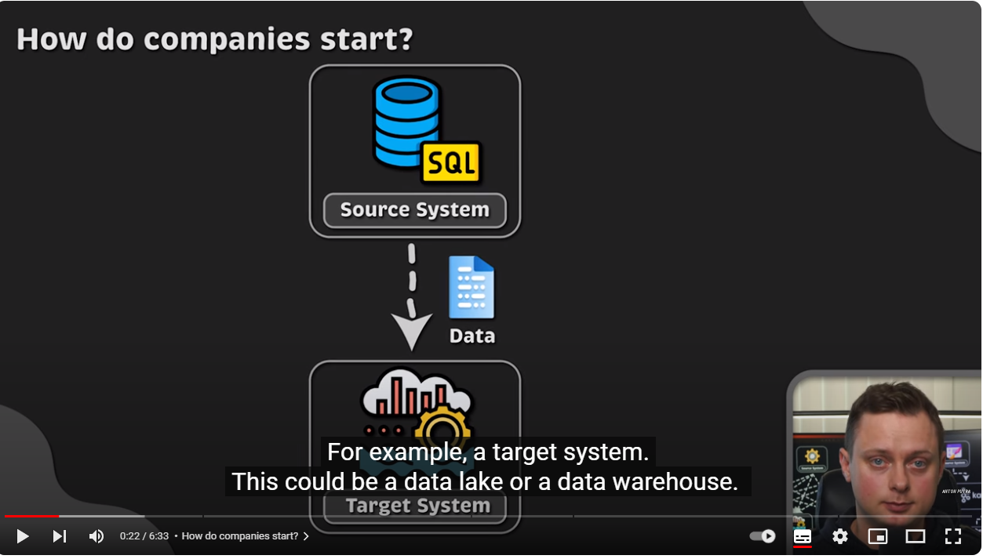

Slide 6
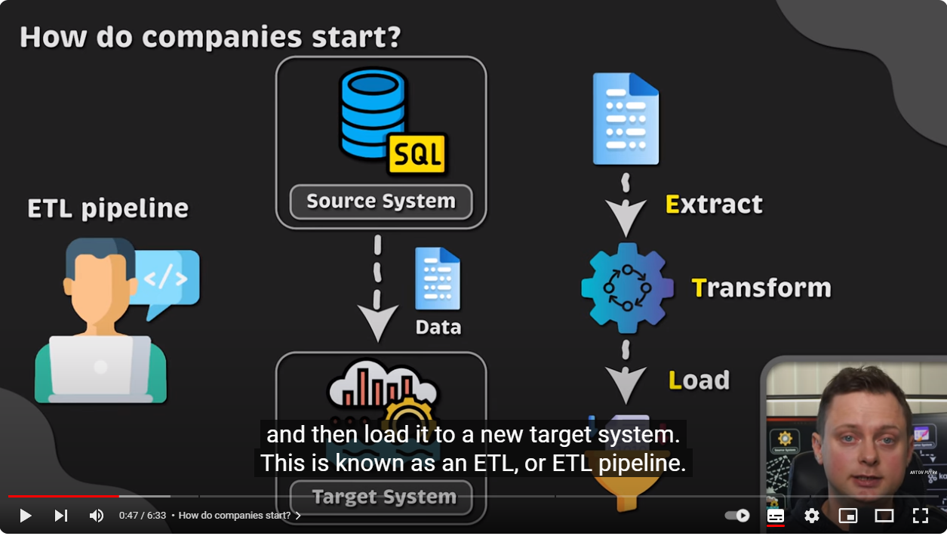

Slide 7
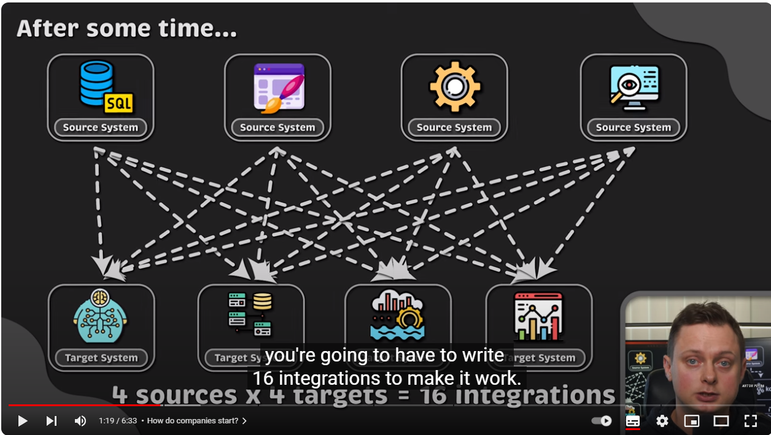

Slide 8
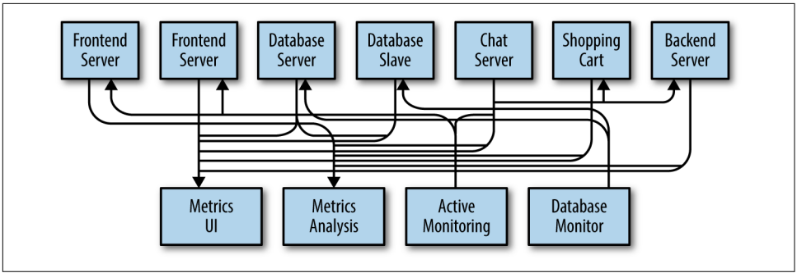

Slide 9
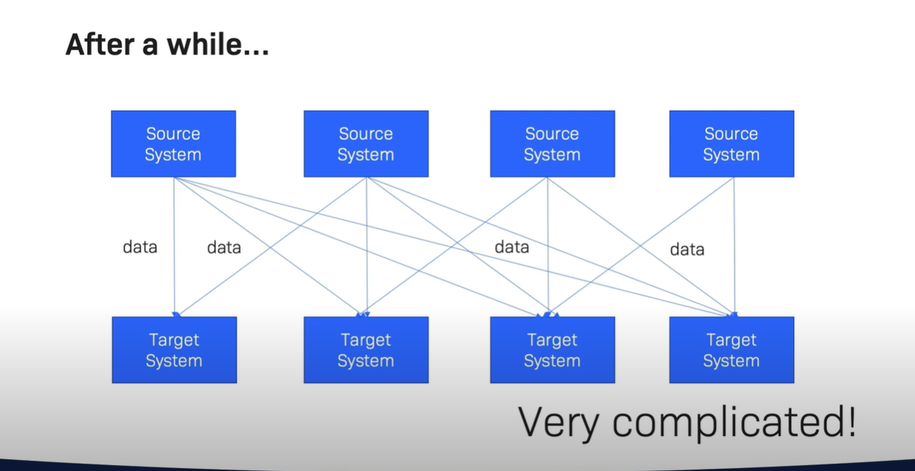

Slide 10
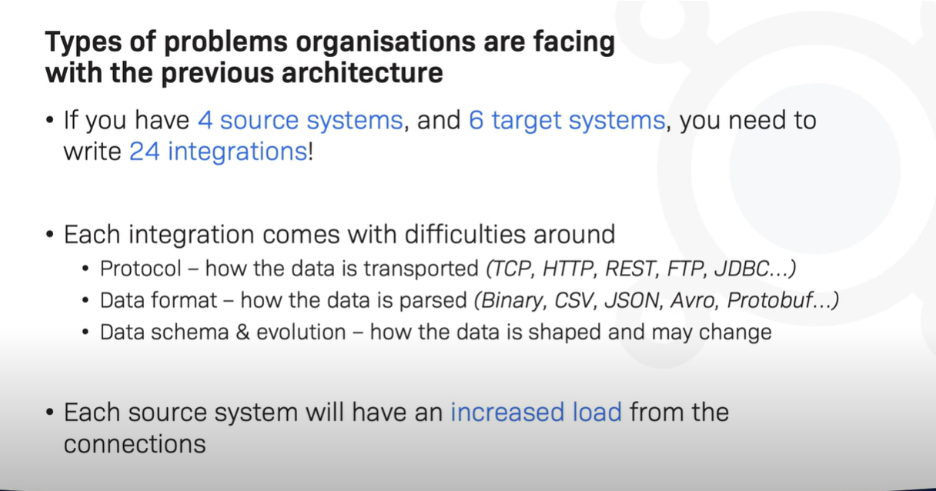

Slide 11
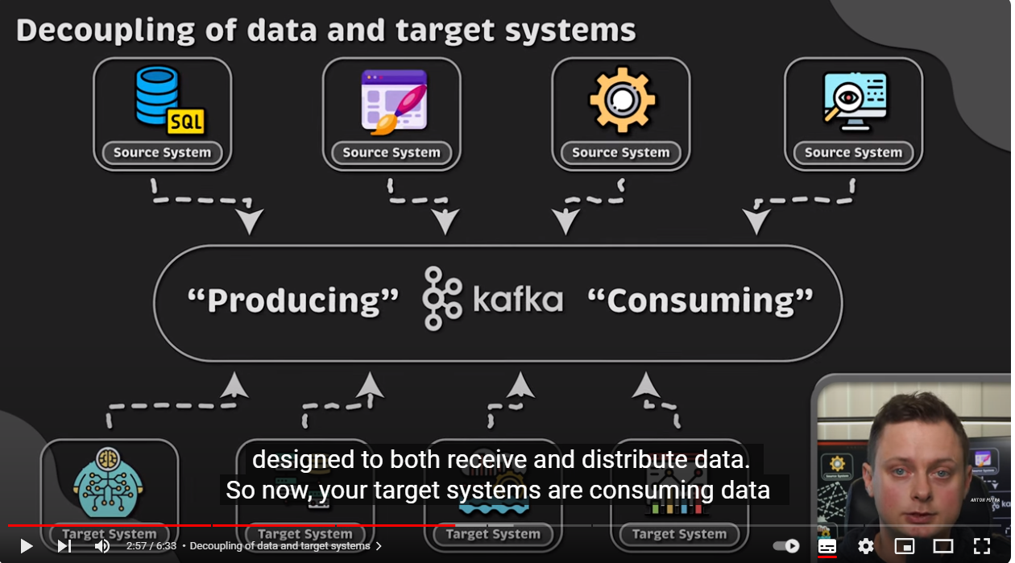

Slide 12
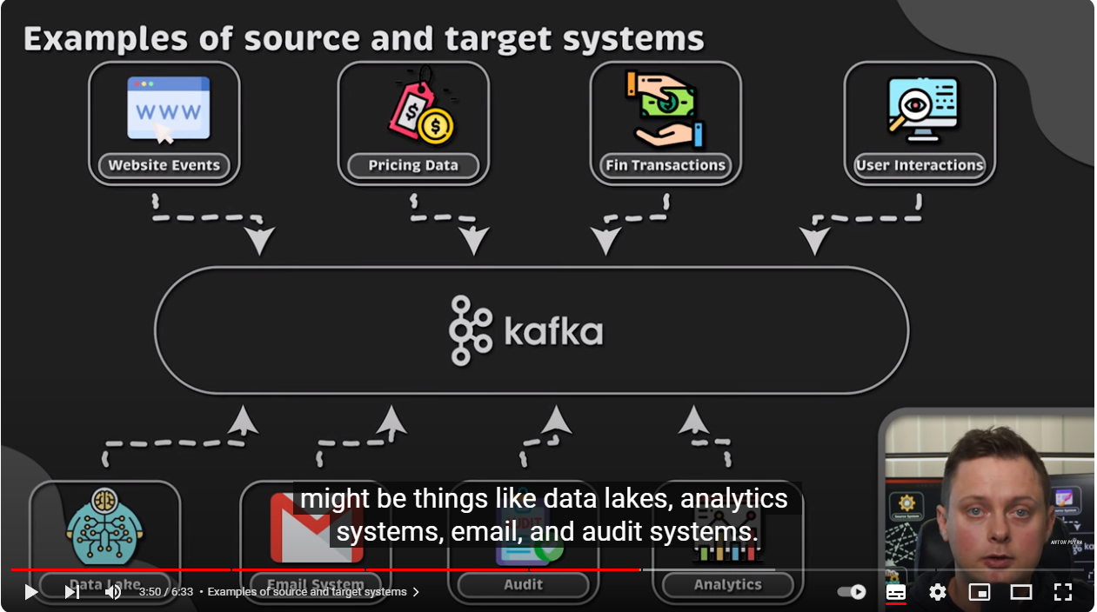

Slide 13
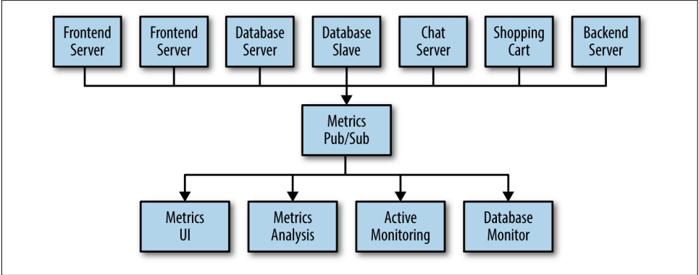
The technical debt built up here is obvious, so you decide to pay some of it back. You set up a single application that receives metrics from all the applications out there, and provide a server to query those metrics for any system that needs them. This reduces the complexity of the architecture to something similar

Slide 14
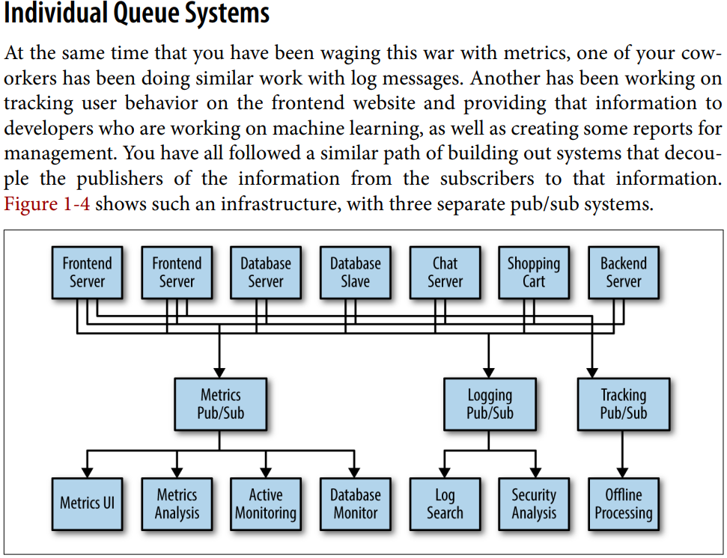

Slide 15
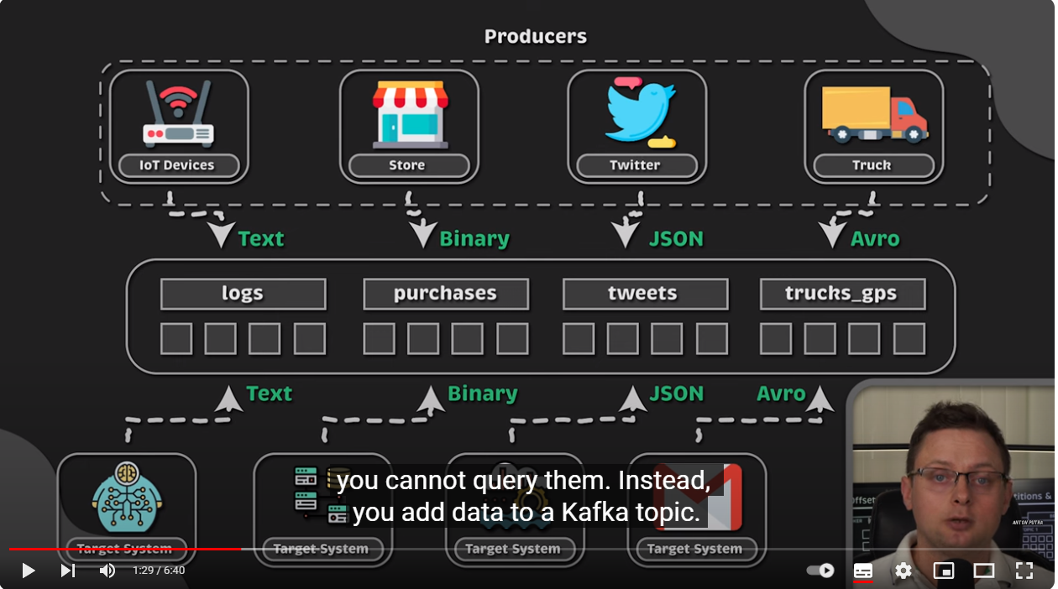

Slide 16
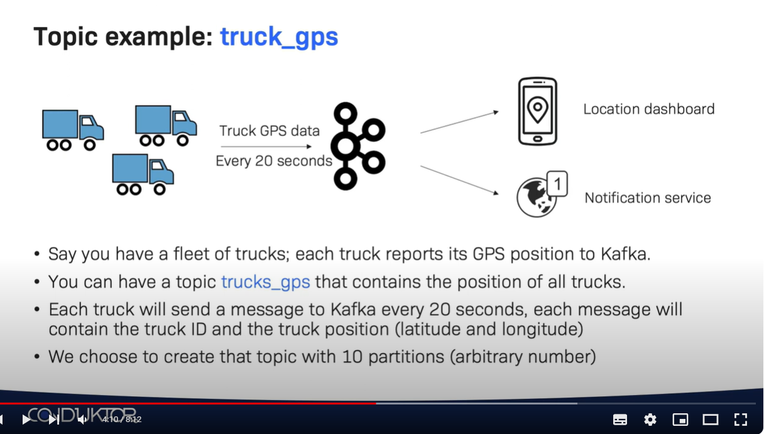

Slide 17
Apache Kafka is a publish/subscribe messaging system designed to solve this prob‐ lem. It is often described as a “distributed commit log” or more recently as a “distrib‐ uting streaming platform.” A filesystem or database commit log is designed to provide a durable record of all transactions so that they can be replayed to consis‐ tently build the state of a system. Similarly, data within Kafka is stored durably, in order, and can be read deterministically. In addition, the data can be distributed within the system to provide additional protections against failures, as well as signifi‐ cant opportunities for scaling performance.

Slide 18
Kafka’s Origin and Use Cases

Slide 19
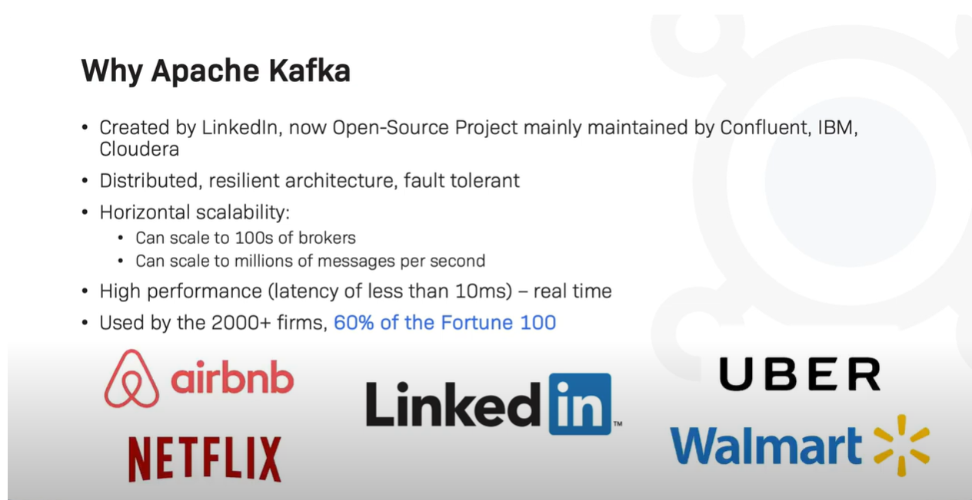

Slide 20
Why Kafka: what makes Apache Kafka a good choice ?
Multiple Producers:
Kafka is able to seamlessly handle multiple producers, whether those clients are using many topics or the same topic. This makes the system ideal for aggregating data from many frontend systems and making it consistent. For example, a site that serves con‐ tent to users via a number of microservices can have a single topic for page views that all services can write to using a common format. Consumer applications can then receive a single stream of page views for all applications on the site without having to coordinate consuming from multiple topics, one for each application.

Slide 21
Multiple Consumers:
In addition to multiple producers, Kafka is designed for multiple consumers to read any single stream of messages without interfering with each other. This is in contrast to many queuing systems where once a message is consumed by one client, it is not available to any other. Multiple Kafka consumers can choose to operate as part of a group and share a stream, assuring that the entire group processes a given message only once.

Slide 22
Scalable:
Kafka’s flexible scalability makes it easy to handle any amount of data. Users can start with a single broker as a proof of concept, expand to a small development cluster of three brokers, and move into production with a larger cluster of tens or even hun‐ dreds of brokers that grows over time as the data scales up. Expansions can be performed while the cluster is online, with no impact on the availability of the system as a whole. This also means that a cluster of multiple brokers can handle the failure of an individual broker, and continue servicing clients.

Slide 23
High Performance
All of these features come together to make Apache Kafka a publish/subscribe messaging system with excellent performance under high load. Producers, consumers, and brokers can all be scaled out to handle very large message streams with ease. This can be done while still providing subsecond message latency from producing a mes‐ sage to availability to consumers

Slide 24
The Data Ecosystem:
Kafka EcoSystem is formed with Kafka Core, Kafka Streams, Kafka Connect, Kafka REST Proxy, and the Schema Registry
When coupled with a system to pro‐ vide message schemas, producers and consumers no longer require tight coupling or direct connections of any sort. Components can be added and removed as business cases are created and dissolved, and producers do not need to be concerned about who is using the data or the number of consuming applications.

Slide 25
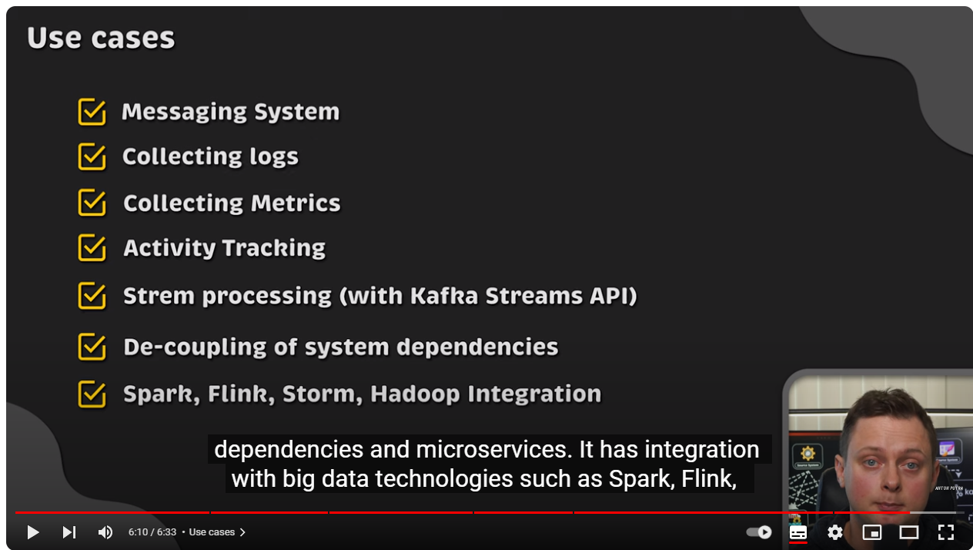

Slide 26
Use Cases
Messaging
Kafka is also used for messaging, where applications need to send notifications (such as emails) to users
Activity tracking
The original use case for Kafka, as it was designed at LinkedIn, is that of user activity tracking. A website’s users interact with frontend applications, which generate mes‐ sages regarding actions the user is taking. This can be passive information, such as page views and click tracking, or it can be more complex actions, such as information that a user adds to their profile. The messages are published to one or more topics, which are then consumed by applications on the backend. These applications may be generating reports, feeding machine learning systems, updating search results, or per‐ forming other operations that are necessary to provide a rich user experience.

Slide 27
Metrics and logging
Kafka is also ideal for collecting application and system metrics and logs. This is a use case in which the ability to have multiple applications producing the same type of message shines. Applications publish metrics on a regular basis to a Kafka topic, and those metrics can be consumed by systems for monitoring and alerting

Slide 28
Kafka architecture

Slide 29
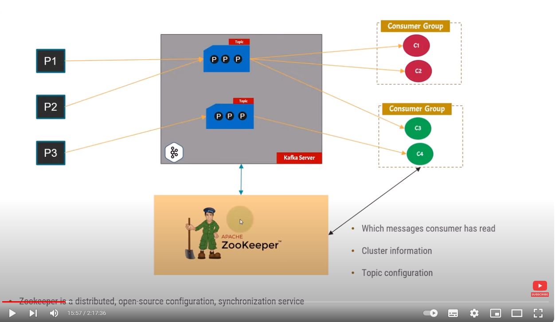

Slide 30
Save Data in another System
Trace Charts
Turn list of Recomendations
Send Notifs
Chat

Slide 31
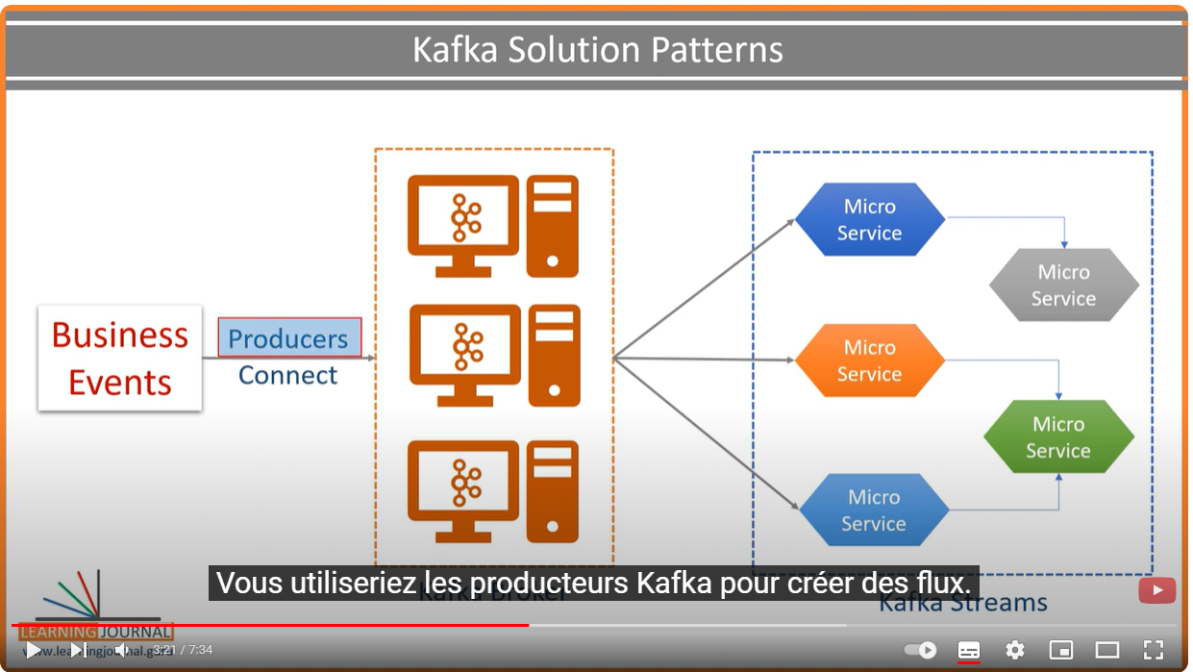

Slide 32
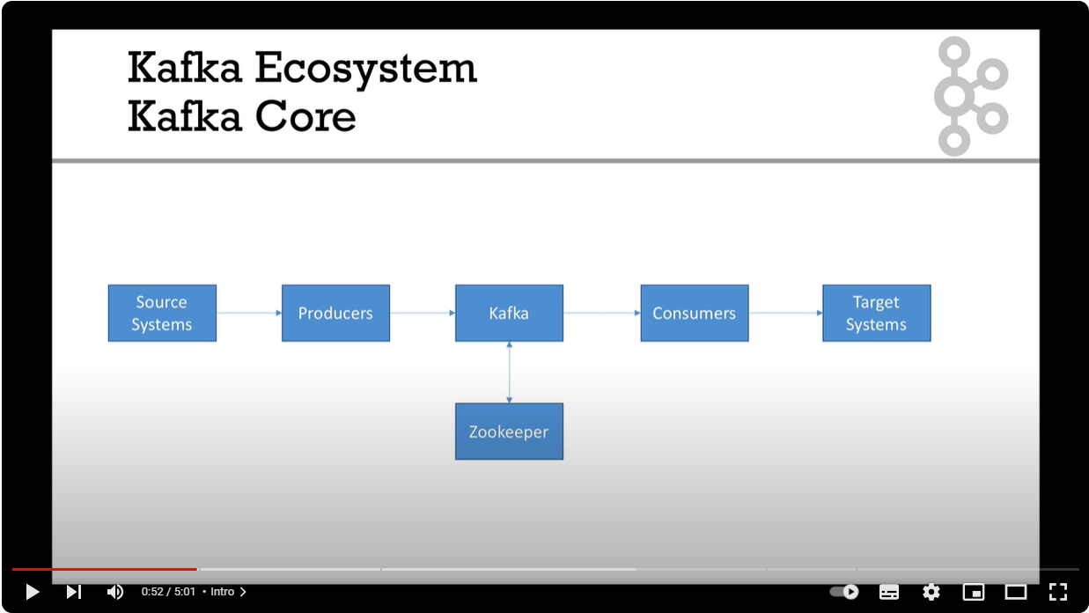

Slide 33
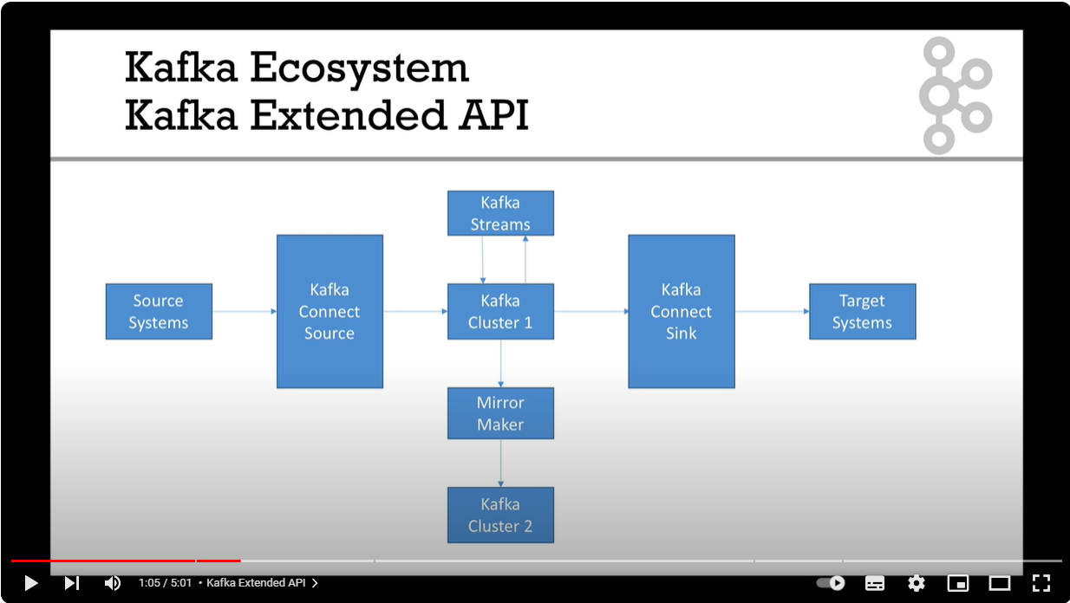

Slide 34
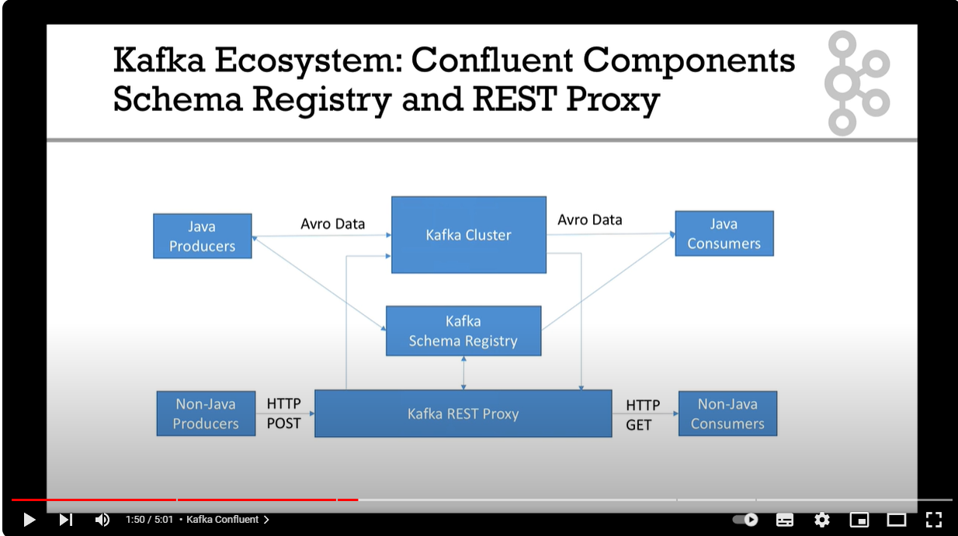

Slide 35
Publish/Subscribe Messaging
Publish/subscribe messaging is a pattern that is characterized by the sender (publisher) of a piece of data (message) not specifically directing it to a receiver. Instead, the publisher classifies the message somehow, and that receiver (subscriber) subscribes to receive certain classes of messages. Pub/sub systems often have a broker, a central point where messages are published, to facilitate this.

Slide 36
Install Kafka server and zookeeper

Slide 37
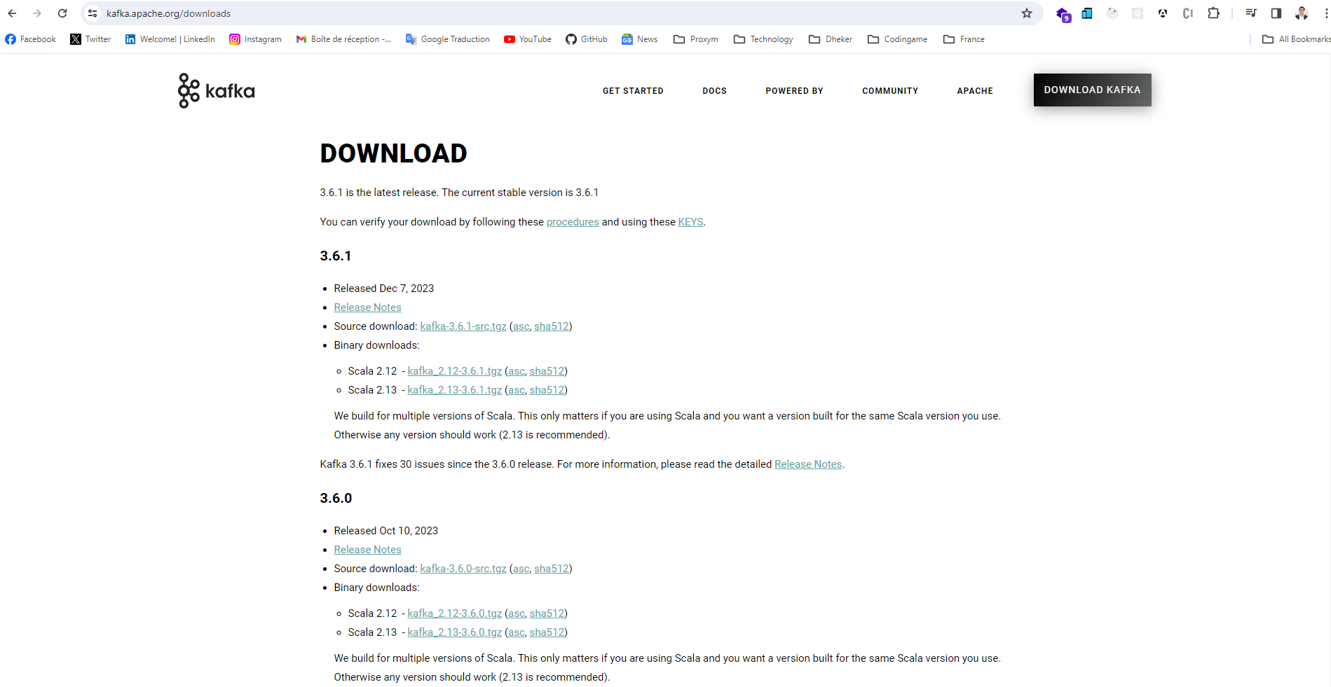

Slide 38
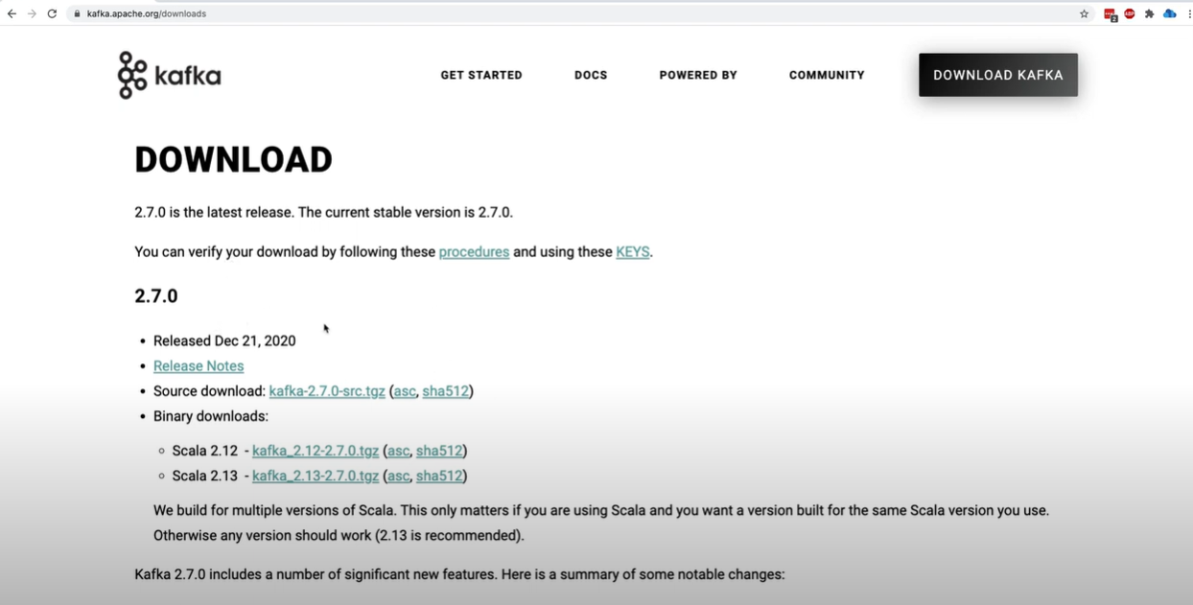
using the downloaded binaries (JVM)

Slide 39
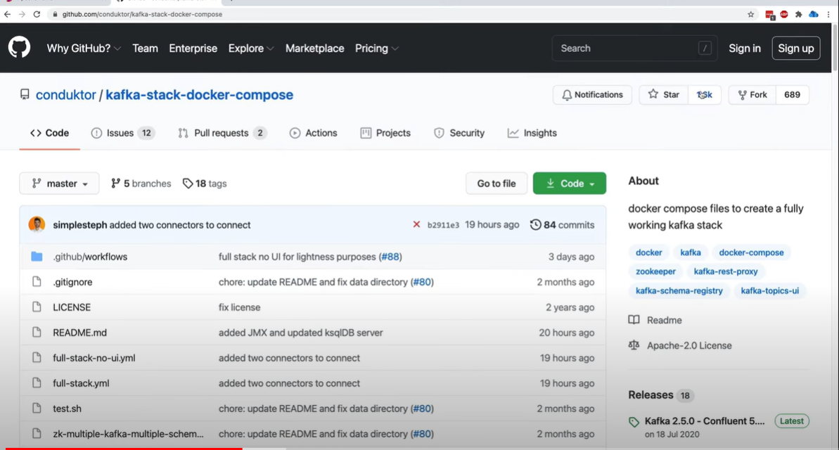
using Docker and Docker-Compose

Slide 40
Interaction With Kafka
Via CLI : ???
$ bin/kafka-console-producer.sh --topic quickstart-events --bootstrap-server localhost:9092
This is my first event
This is my second event

Slide 41
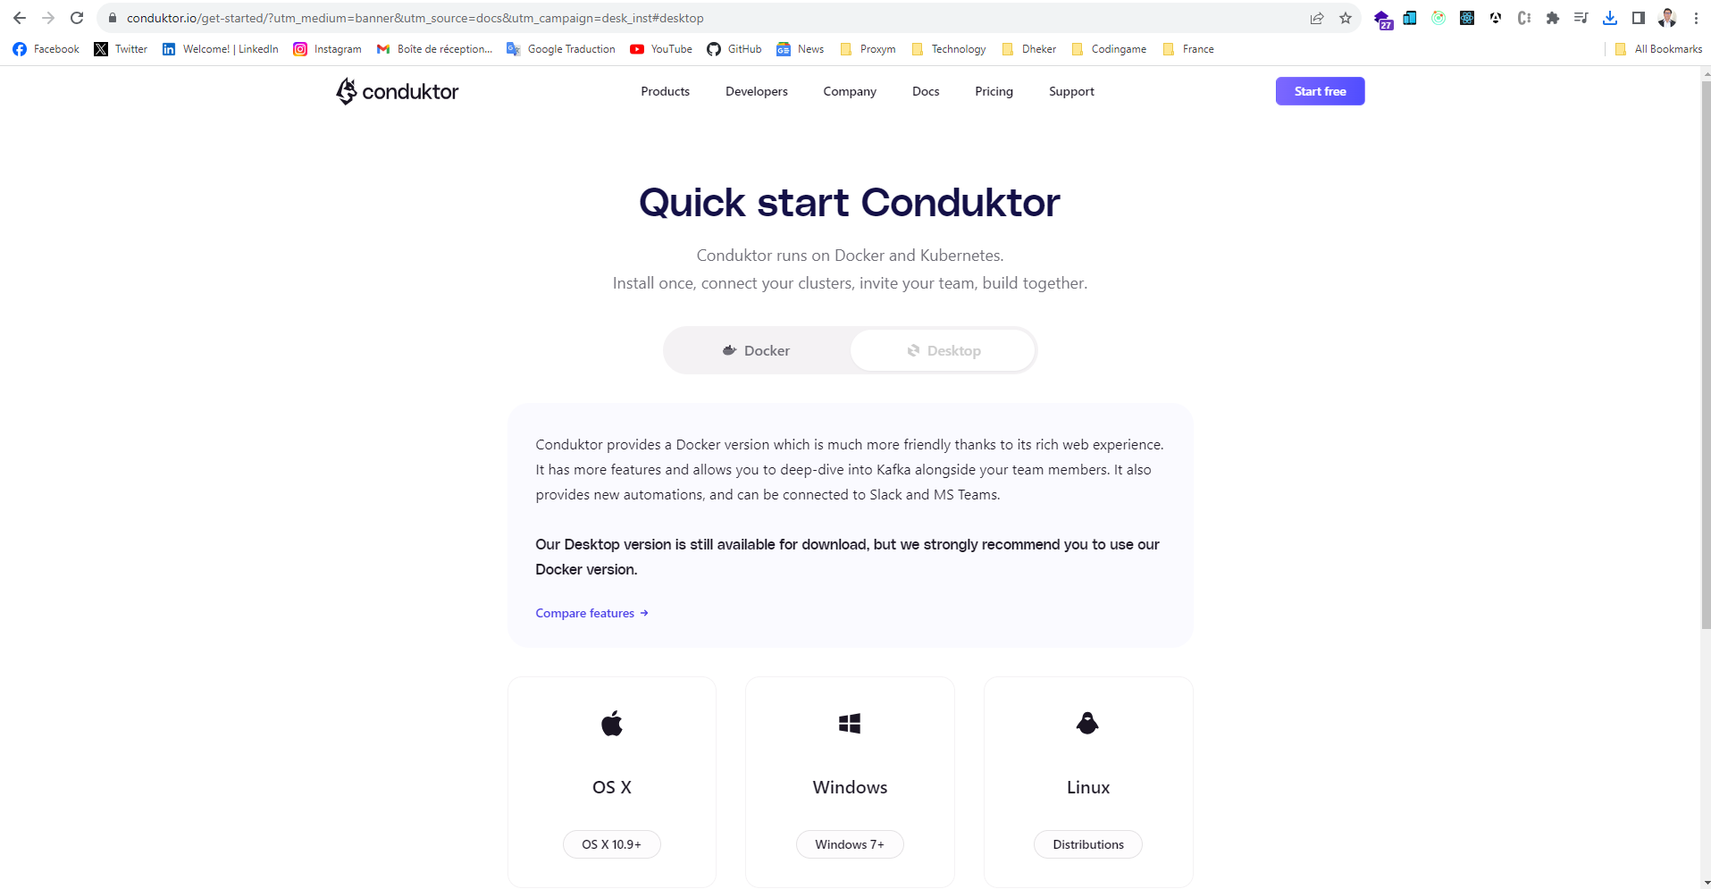
Graphical User Interface

Slide 42
Kafka Server

Slide 43
Topics and Partitions
Messages in Kafka are categorized into topics
The closest analogies for a topic are a database table or a folder in a filesystem
Topics are divided into a number of partitions
the “commit log” description: a partition is a single log.
Messages are written to it in an append-only fashion, and are read in order from beginning to end
Note that as a topic typically has multiple partitions, there is no guarantee of message time-ordering across the entire topic

Slide 44
The offset
The offset is another bit of metadata—an integer value that continually increases—that Kafka adds to each message as it is produced. Each message in a given partition has a unique offset. By storing the offset of the last consumed message for each partition, either in Zookeeper or in Kafka itself, a consumer can stop and restart without losing its place.

Slide 45
Brokers and Clusters
A single Kafka server is called a broker. The broker receives messages from producers, assigns offsets to them, and commits the messages to storage on disk. It also services consumers, responding to fetch requests for partitions and responding with the mes‐ sages that have been committed to disk. Depending on the specific hardware and its performance characteristics, a single broker can easily handle thousands of partitions and millions of messages per second.

Slide 46
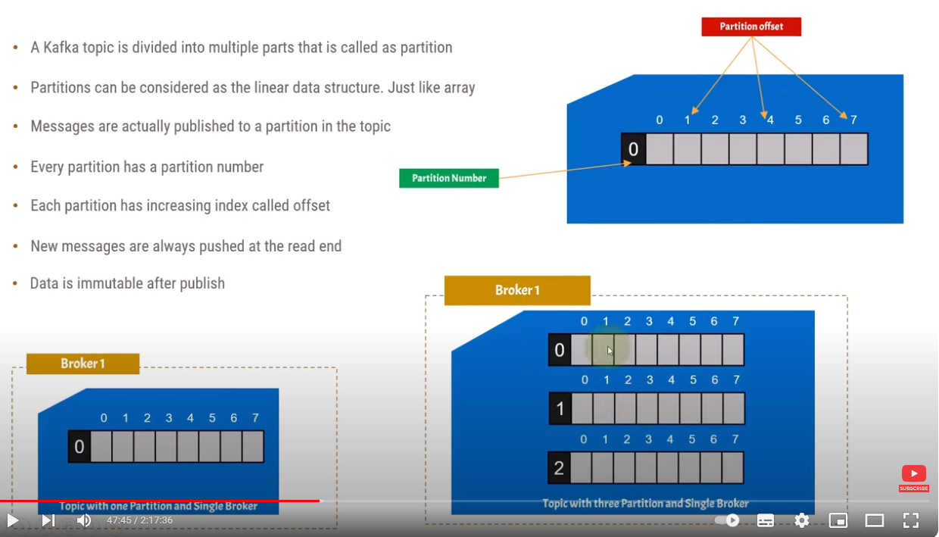

Slide 47
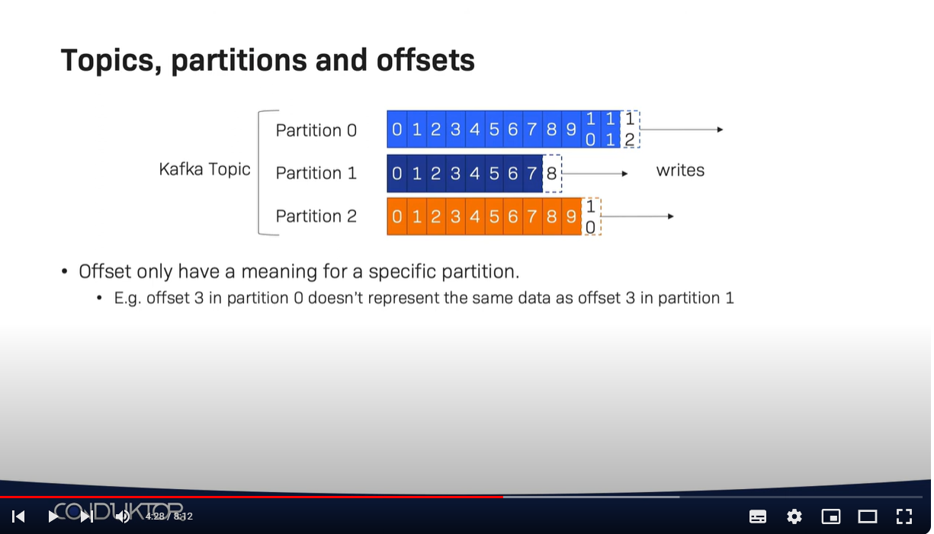

Slide 48
Topic Configurations
num.partitions: parameter determines how many partitions a new topic is created with, primarily when automatic topic creation is enabled (which is the default setting). This parameter defaults to one partition. Keep in mind that the number of partitions for a topic can only be increased, never decreased. This means that if a topic needs to have fewer partitions than num.partitions, care will need to be taken to manually create the topic
Partitions are the way a topic is scaled within a Kafka clus‐ ter, which makes it important to use partition counts that will balance the message load across the entire cluster as brokers are added. Many users will have the partition count for a topic be equal to, or a multiple of, the number of brokers in the cluster. This allows the partitions to be evenly distributed to the brokers, which will evenly distribute the message load. This is not a requirement, however, as you can also bal‐ ance message load by having multiple topics.

Slide 49
How to Choose the Number of Partitions
What is the throughput you expect to achieve for the topic? For example, do you expect to write 100 KB per second or 1 GB per second?
Consider the number of partitions you will place on each broker and available diskspace and network bandwidth per broker.
Avoid overestimating, as each partition uses memory and other resources on the broker and will increase the time for leader elections.

Slide 50
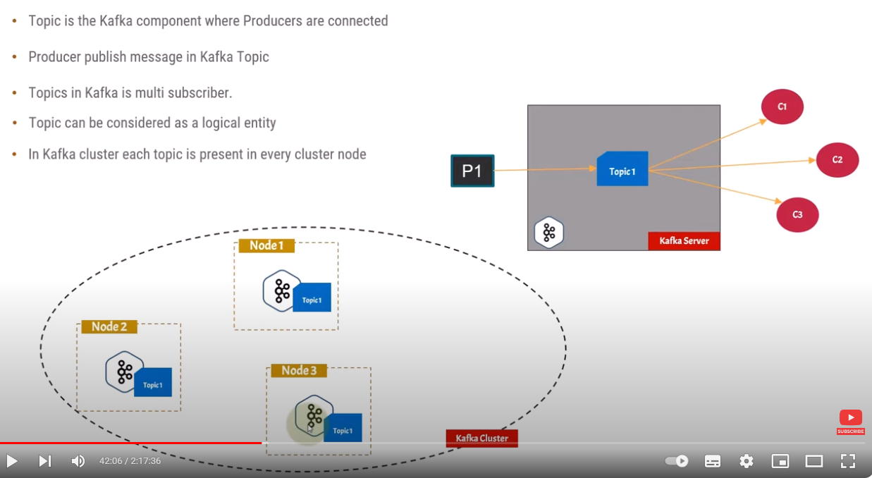

Slide 51
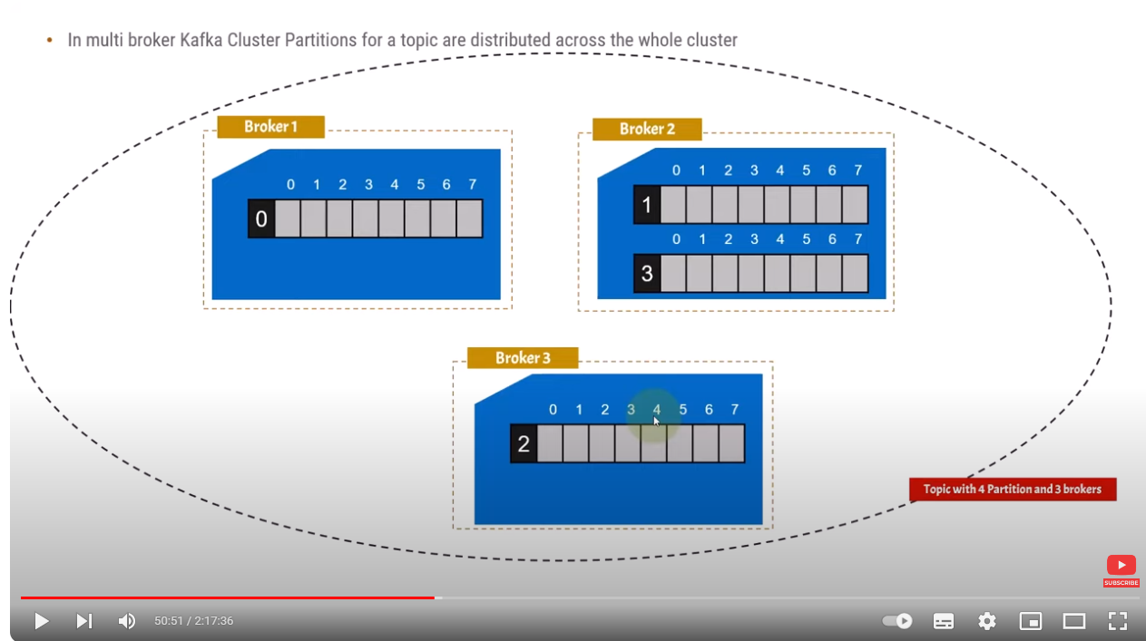

Slide 52
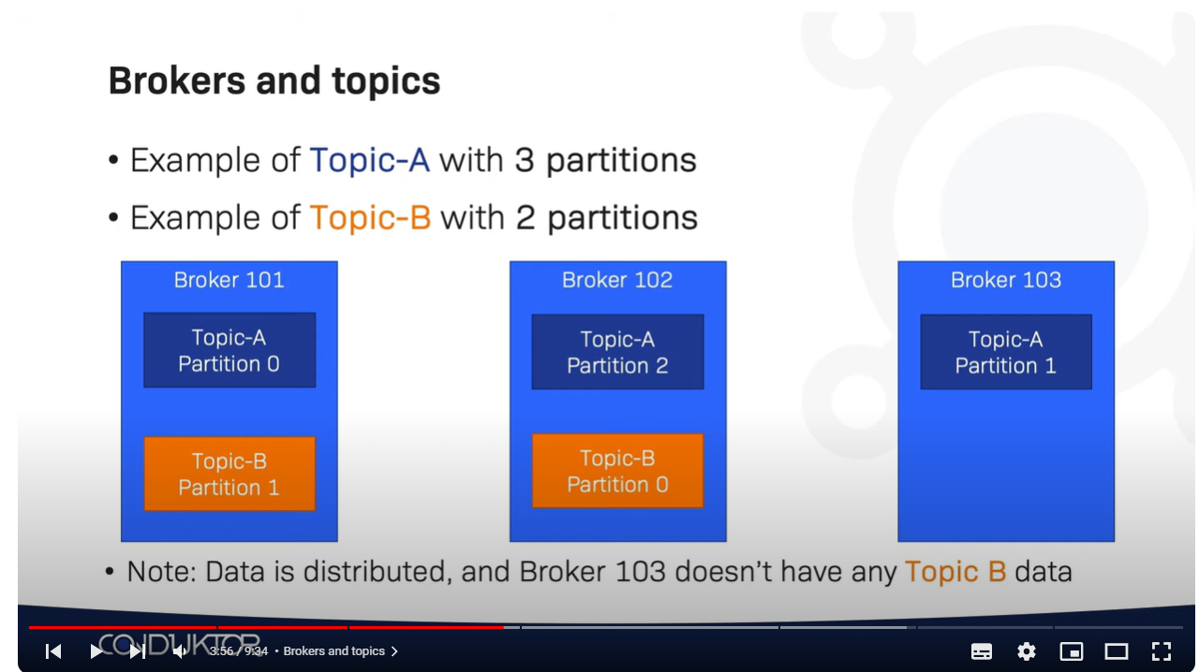

Slide 53
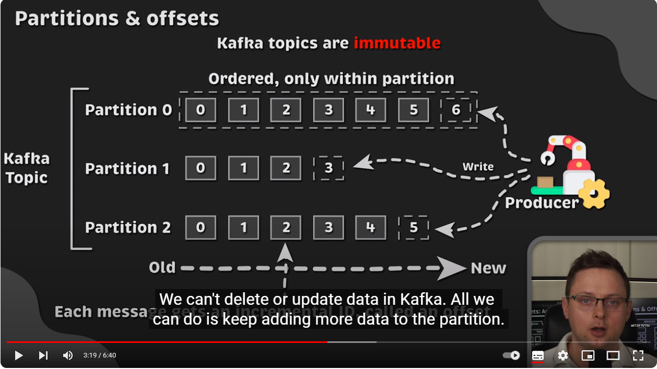

Slide 54
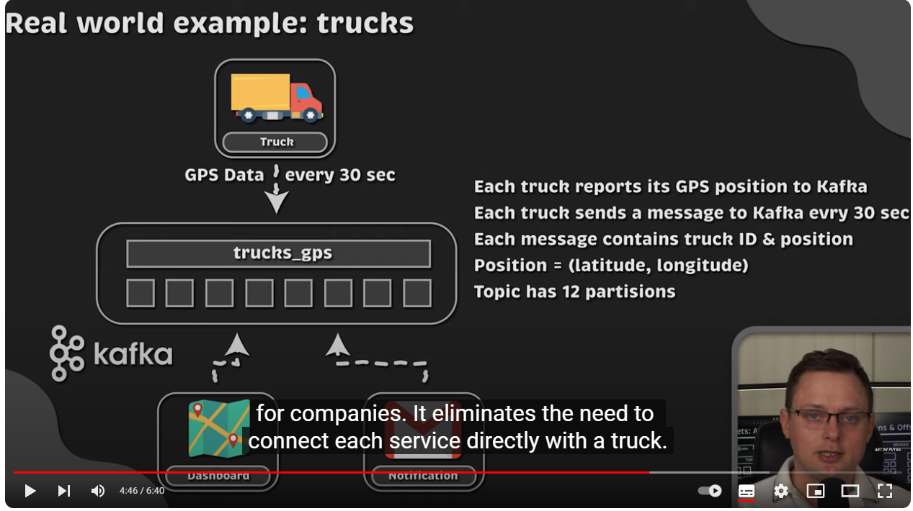

Slide 55
Kafka Server
Broker
Broker.id: 1
Topic
Partitions
Broker.id: 0
Broker
Broker
Broker.id: 2

Slide 56
Replication
Kafka brokers are designed to operate as part of a cluster. Within a cluster of brokers, one broker will also function as the cluster controller (elected automatically from the live members of the cluster). The controller is responsible for administrative opera‐ Enter Kafka | 7 tions, including assigning partitions to brokers and monitoring for broker failures. A partition is owned by a single broker in the cluster, and that broker is called the leader of the partition

Slide 57
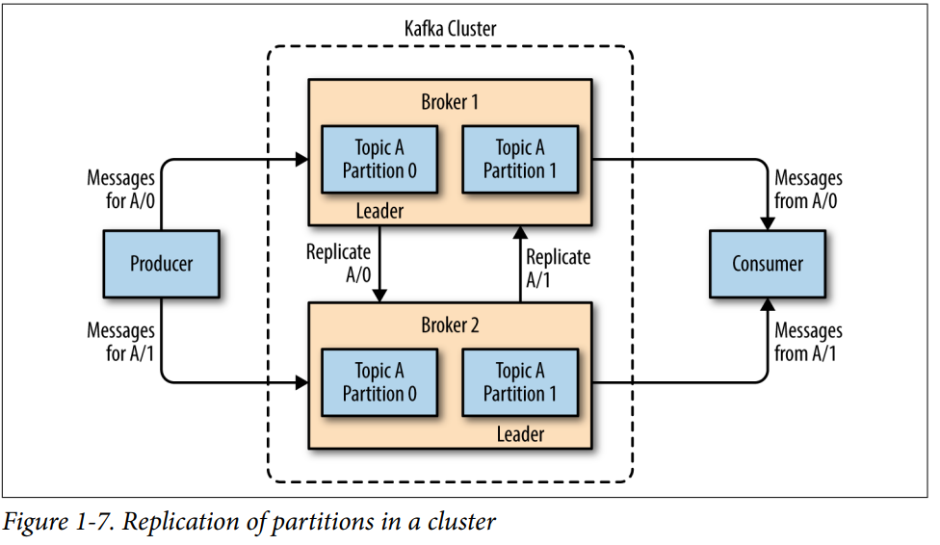

Slide 58
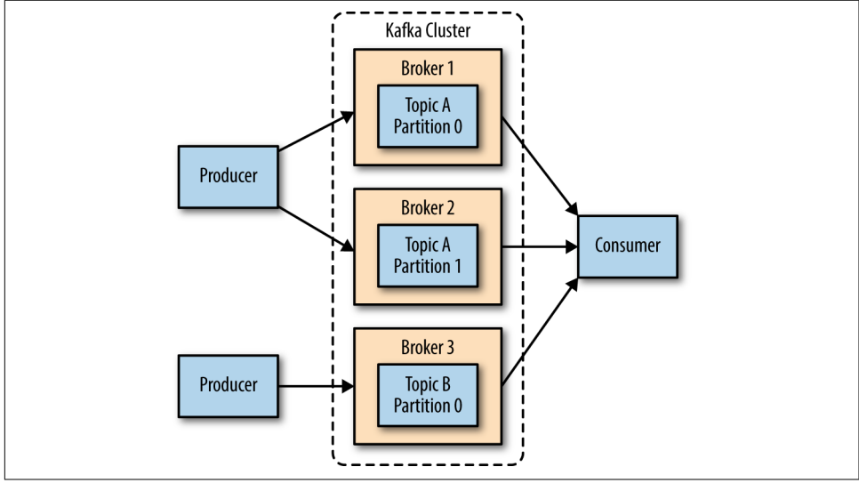
Replication always is implemented at the partition level (Not Broker or Topic Level: Just partition level)
The biggest benefit is the ability to scale the load across multiple servers. A close second is using replication to guard against data loss due to single system failures. Replication will also allow for performing mainte‐ nance work on Kafka or the underlying systems while still maintaining availability for clients

Slide 59
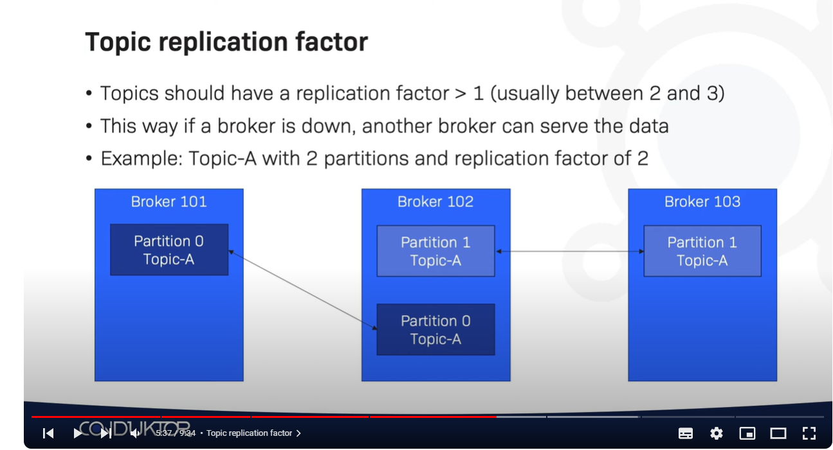

Slide 60
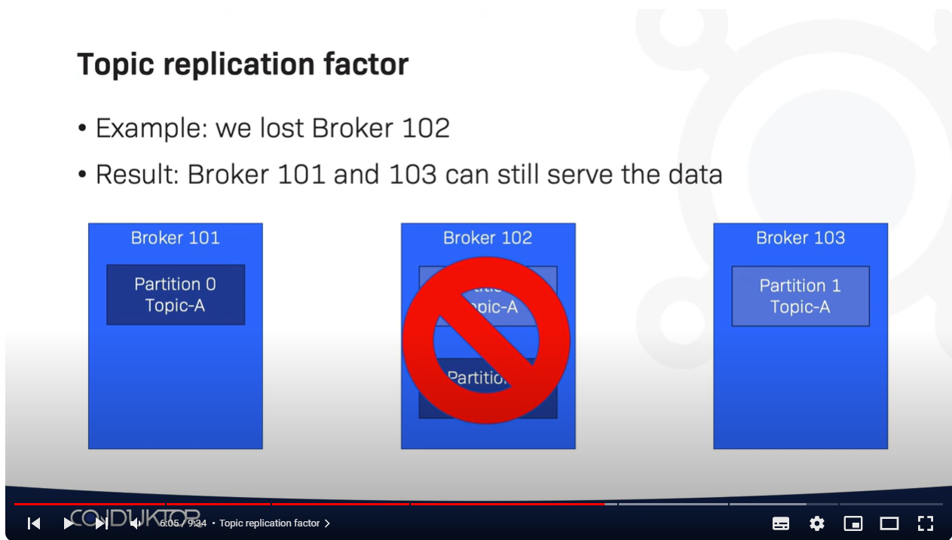

Slide 61
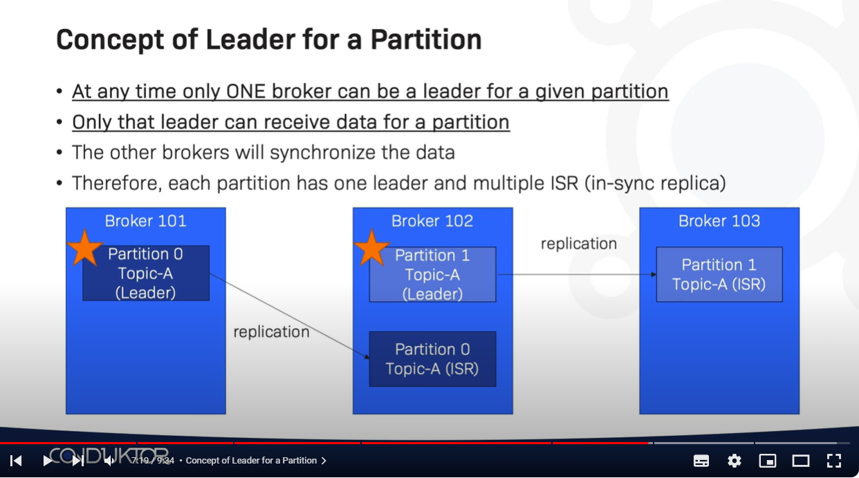

Slide 62
Retention
is the durable storage of messages for some period of time
Kafka brokers are configured with a default reten‐ tion setting for topics
Retaining messages for some period of time (e.g., 7 days)
Until the topic reaches a certain size in bytes (e.g., 1 GB)

Slide 63
Configuration Retention by time:
log.retention.hours, log.retention.minutes, log.retention.ms
All three of these specify the same configuration—the amount of time after which messages may be deleted but the recommended parameter to use is log.retention.ms
Default value: log.retention.hours=168 (one week)
Configuration Retention by size:
log.retention.bytes:
Another way to expire messages is based on the total number of bytes of messages retained
it is applied per-partition: This means that if you have a topic with 8 partitions, and log.retention.bytes is set to 1 GB, the amount of data retained for the topic will be 8 GB at most

Slide 64
Configuring Retention by Size and Time
If you have specified a value for both log.retention.bytes and log.retention.ms (or another parameter for retention by time), messages may be removed when either criteria is met. For example, if log.retention.ms is set to 86400000 (1 day) and log.reten tion.bytes is set to 1000000000 (1 GB), it is possible for messages that are less than 1 day old to get deleted if the total volume of mes‐ sages over the course of the day is greater than 1 GB. Conversely, if the volume is less than 1 GB, messages can be deleted after 1 day even if the total size of the partition is less than 1 GB

Slide 65
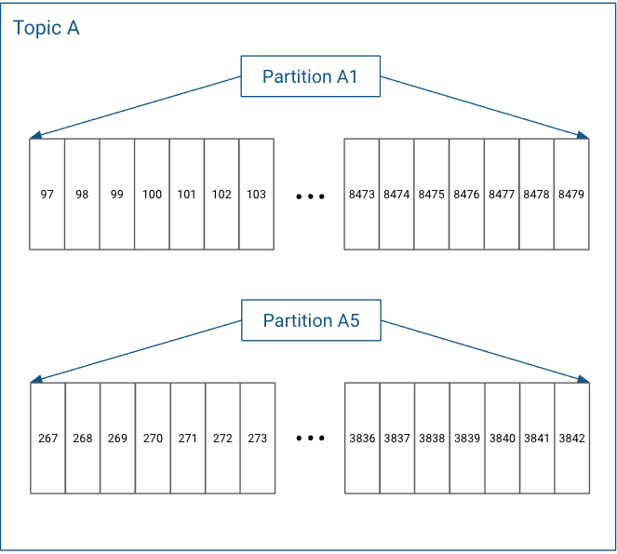
Configuring Retention by log segments by Size: log.segment.bytes
Partitions in Log Structured Format

Slide 66
In actuality, each partition does not keep all the records sequentially in a single file. Instead, it breaks each log into log segments. Log segments can be defined using a size limit (for example, 1 GB), as a time limit (for example, 1 day), or both. Administration around Kafka records often occurs at the log segment level.
Each of the partitions is broken into segments, with Segment N containing the most recent records and Segment 1 containing the oldest retained records. This is configurable on a per-topic basis.

Slide 67
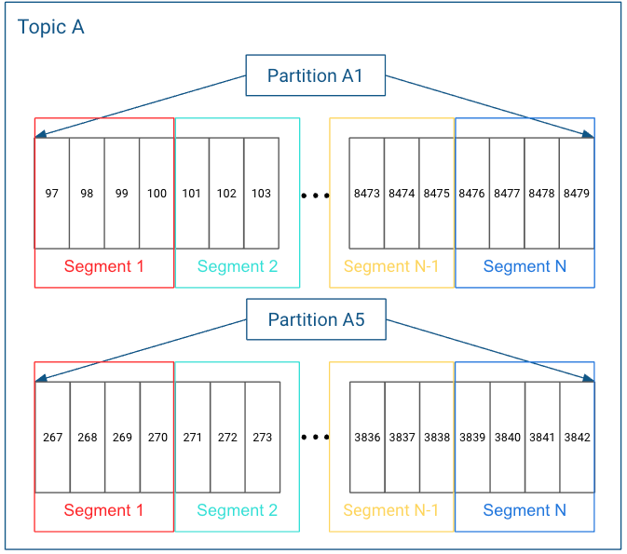

Slide 68
As messages are produced to the Kafka broker, they are appended to the current log segment for the partition. Once the log segment has reached the size specified by the log.segment.bytes parameter, which defaults to 1 GB, the log seg‐ ment is closed and a new one is opened. Once a log segment has been closed, it can be considered for expiration. A smaller log-segment size means that files must be closed and allocated more often, which reduces the overall efficiency of disk writes.
Adjusting the size of the log segments can be important if topics have a low produce rate. For example, if a topic receives only 100 megabytes per day of messages, and log.segment.bytes is set to the default, it will take 10 days to fill one segment. As messages cannot be expired until the log segment is closed, if log.retention.ms is set to 604800000 (1 week), there will actually be up to 17 days of messages retained until the closed log segment expires. This is because once the log segment is closed with the current 10 days of messages, that log segment must be retained for 7 days before it expires based on the time policy (as the segment cannot be removed until the last message in the segment can be expired).

Slide 69
Configuring Retention by log segments by Time: log.segment.ms
Another way to control when log segments are closed is by using the log.segment.ms parameter, which specifies the amount of time after which a log segment should be closed. As with the log.retention.bytes and log.retention.ms parameters, log.segment.bytes and log.segment.ms are not mutually exclusive properties. Kafka will close a log segment either when the size limit is reached or when the time limit is reached, whichever comes first. By default, there is no setting for log.seg ment.ms, which results in only closing log segments by size.

Slide 70
Configuring Kafka Brokers
message.max.bytes
The Kafka broker limits the maximum size of a message that can be produced, con‐ figured by the message.max.bytes parameter, which defaults to 1000000, or 1 MB. A producer that tries to send a message larger than this will receive an error back from the broker, and the message will not be accepted.

Slide 71
How Many Brokers For cluster
how much disk capacity is required for retaining messages and how much storage is available on a single broker
the capacity of the cluster to handle requests
Broker Configuration:
There are only two requirements in the broker configuration to allow multiple Kafka brokers to join a single cluster.

Slide 72
The controller : is one of the Kafka brokers that, in addition to the usual broker func‐ tionality, is responsible for electing partition leaders
The first broker that starts in the cluster becomes the controller by creating an ephemeral node in ZooKeeper called /control ler
When other brokers start, they also try to create this node, but receive a “node already exists” exception
The brokers create a Zoo‐ keeper watch on the controller node so they get notified of changes to this node. This way, we guarantee that the cluster will only have one controller at a time.

Slide 73
When the controller broker is stopped or loses connectivity to Zookeeper, the ephem‐ eral node will disappear
Other brokers in the cluster will be notified through the Zookeeper watch that the controller is gone and will attempt to create the controller node in Zookeeper themselves
The first node to create the new controller in Zookeeper is the new controller, while the other nodes will receive a “node already exists” exception and re-create the watch on the new controller node
Each time a controller is elected, it receives a new, higher controller epoch number through a Zookeeper con‐ ditional increment operation

Slide 74
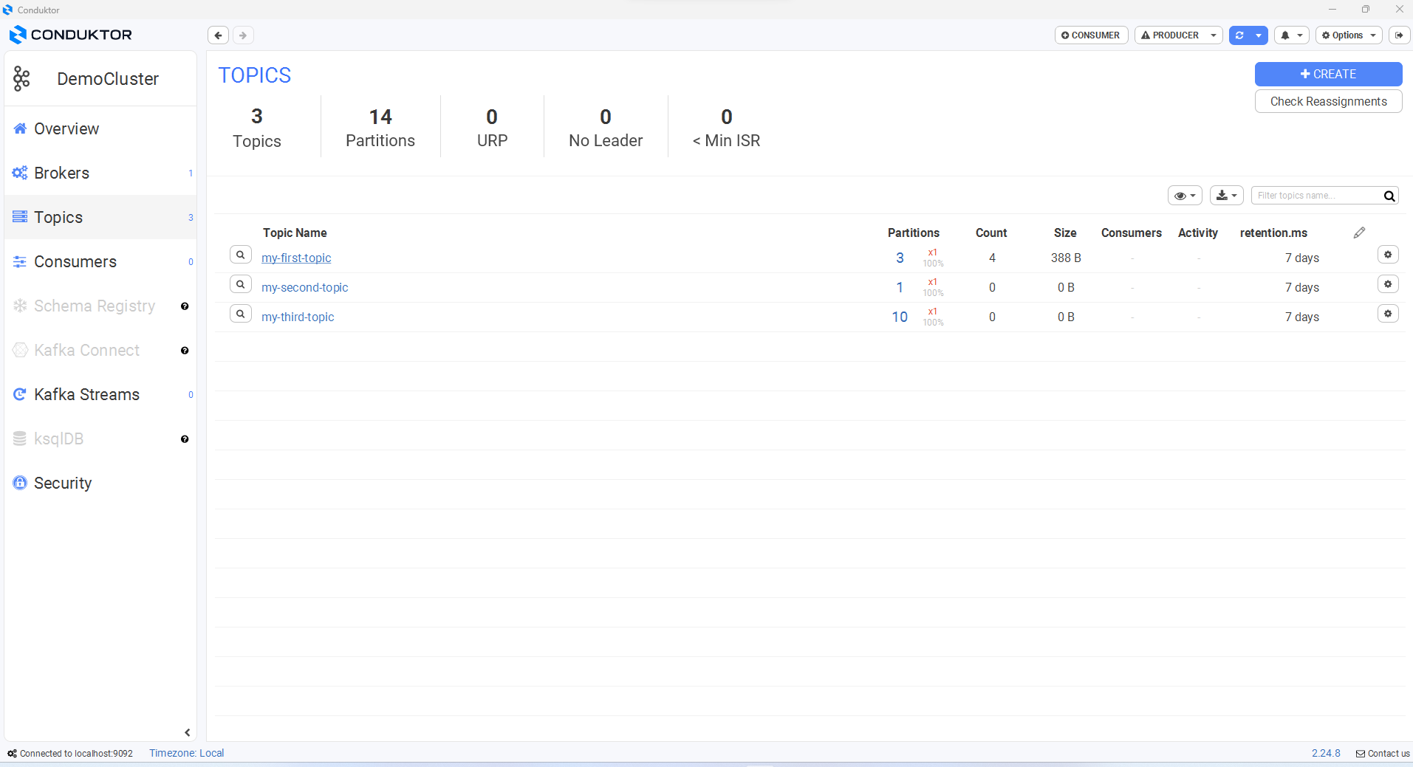

Slide 75
Producer

Slide 76
Producers create new messages. In other publish/subscribe systems, these may be called publishers or writers. In general, a message will be produced to a specific topic. By default, the producer does not care what partition a specific message is written to and will balance messages over all partitions of a topic evenly. In some cases, the pro‐ ducer will direct messages to specific partitions. This is typically done using the mes‐ sage key and a partitioner that will generate a hash of the key and map it to a specific partition. This assures that all messages produced with a given key will get written to the same partition.

Slide 77
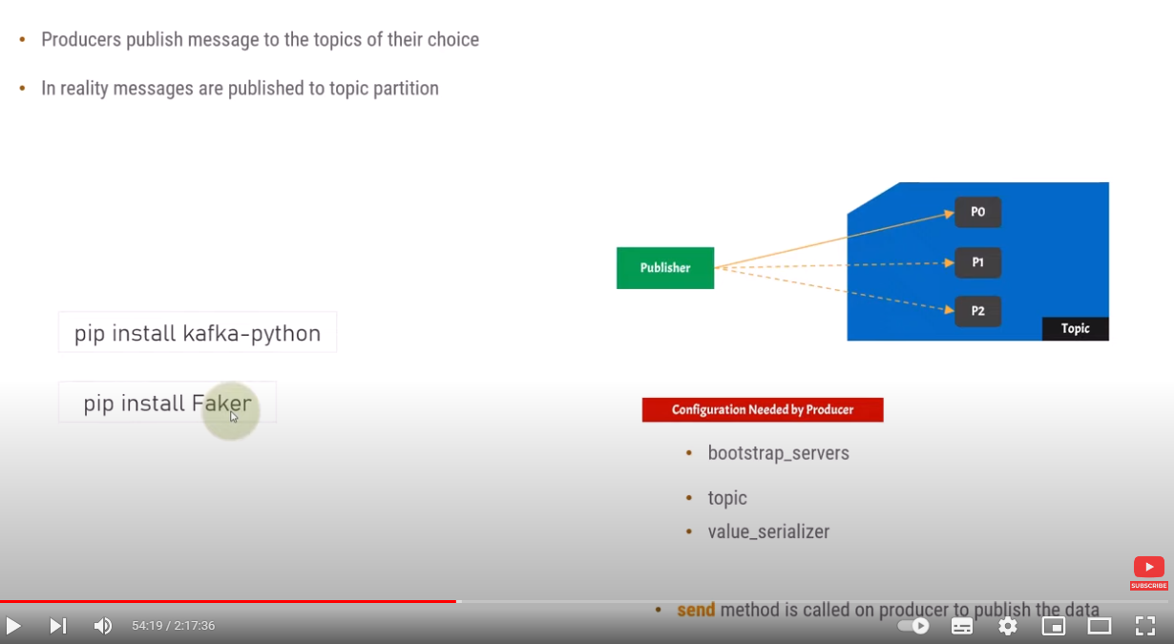

Slide 78
Send Message
Message * : Hello
Topic *: Greeting
(0)
Configuration
Bootsap server:
Port

Slide 79
ProducerRecord
Topic: Greeting
Message: Hello
(2) Serialize
ByteArrays
(3) Sent Message
Creation a Java object
Producer
Return
Broker (Server)
With Key
RecordMetadata
Topic
Partition
offset
Specific Partition
Return Error
Save
Successfully Written
Random Partition
Without Key
Failed written
Save Message in Partition
Save
Exception

Slide 80
Configuration a Kafka Producer
A Kafka producer : Has three mandatory properties
bootstrap.servers: List of host:port pairs of brokers that the producer will use to establish initial connection to the Kafka cluster
key.serializer: Name of a class that will be used to serialize the keys of the records we will pro‐ duce to Kafka : implement “org.apache.kafka.common.serialization.Serializer”
value.serializer: Name of a class that will be used to serialize the values of the records we will pro‐ duce to Kafka : implement “org.apache.kafka.common.serialization.Serializer

Slide 81
Creating a Kafka Producer
private Properties kafkaProps = new Properties();
kafkaProps.put("bootstrap.servers", "broker1:9092,broker2:9092");
kafkaProps.put("key.serializer","org.apache.kafka.common.serialization.StringSerializer");
kafkaProps.put("value.serializer", "org.apache.kafka.common.serialization.StringSerializer");
producer = new KafkaProducer<String, String>(kafkaProps);

Slide 82
There are three primary methods of sending messages
Fire-and-forget :
We send a message to the server and don’t really care if it arrives succesfully or not
ProducerRecord record = new ProducerRecord<>("CustomerCountry", "Precision Products", "France");
try {
producer.send(record);
} catch (Exception e) {
e.printStackTrace();
}

Slide 83
Synchronous send :
We send a message, the send() method returns a Future object, and we use get() to wait on the future and see if the send() was successful or not.
ProducerRecord record = new ProducerRecord<>("CustomerCountry", "Precision Products", "France");
try {
producer.send(record).get();
} catch (Exception e) {
e.printStackTrace();
}

Slide 84
Asynchronous send :
We call the send() method with a callback function, which gets triggered when it receives a response from the Kafka broker
private class DemoProducerCallback implements Callback {
@Override public void onCompletion(RecordMetadata recordMetadata, Exception e) {
if (e != null) {
e.printStackTrace();
}
}
}
ProducerRecord record = new ProducerRecord<>("CustomerCountry", "Biomedical Materials", "USA"); producer.send(record, new DemoProducerCallback());

Slide 85
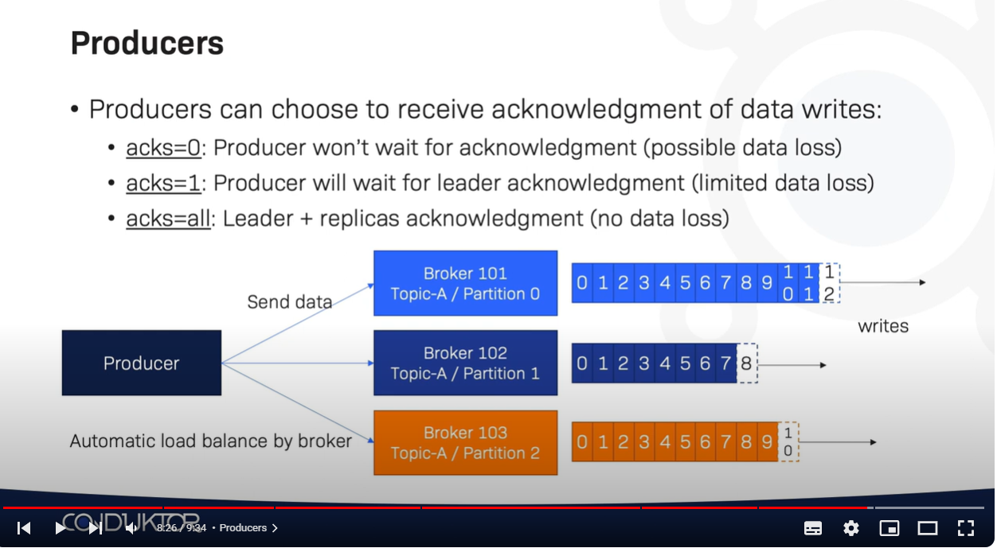

Slide 86
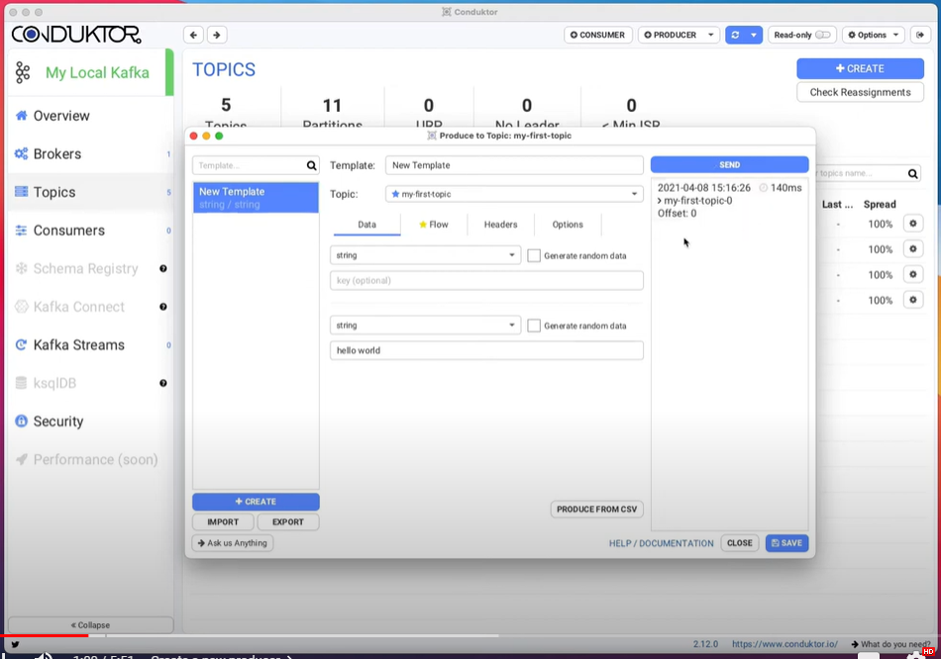

Slide 87
Consumers and Consumer Groups

Slide 88
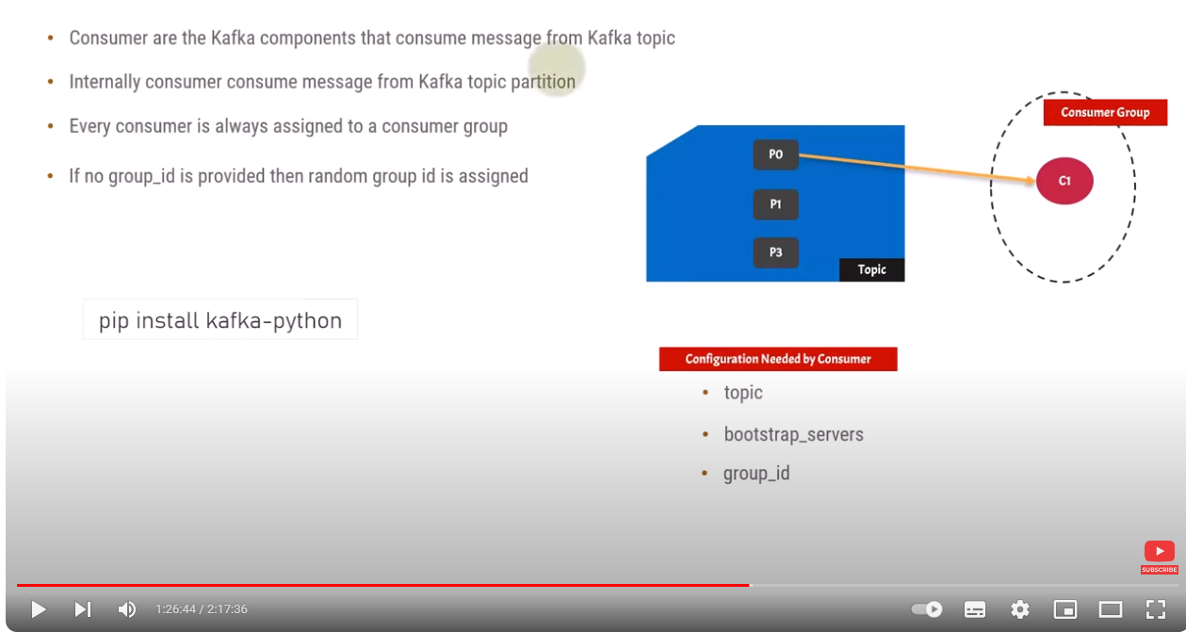

Slide 89
A consumer has to be associated with a Consumer Group: Every consumer is always assigned to a consumer group
-> If no group_id is assigned default, then random group is is assigned by Kafka
When multiple consumers are subscribed to a topic and belong to the same consumer group, each consumer in the group will receive messages from a different subset of the partitions in the topic

Slide 90
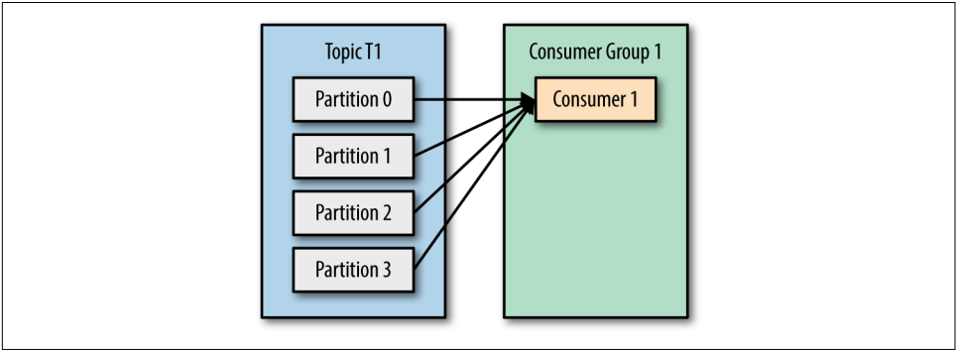
T1 with four partitions
C1 which is the only consumer in group G1 : will get all messages from all four t1 partitions

Slide 91
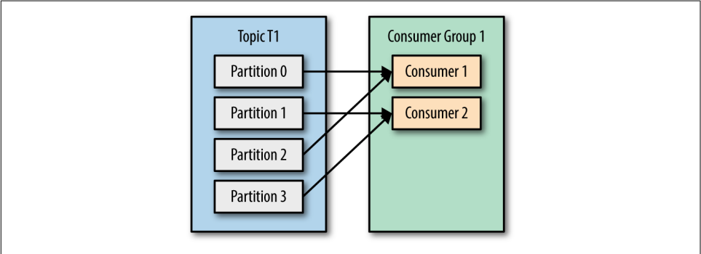
T1 with four partitions
C1,C2 consumers in group G1 :
=> each consumer will only get messages from two partitions
=> Perhaps messages from partition 0 and 2 go to C1 and messages from partitions 1 and 3 go to consumer C2

Slide 92
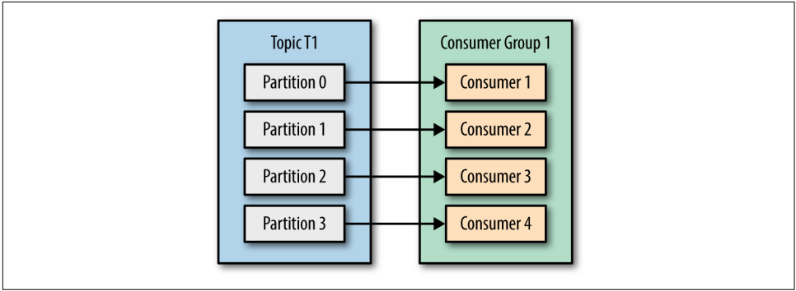
G1 has four consumers, then each will read messages from a single partition

Slide 93
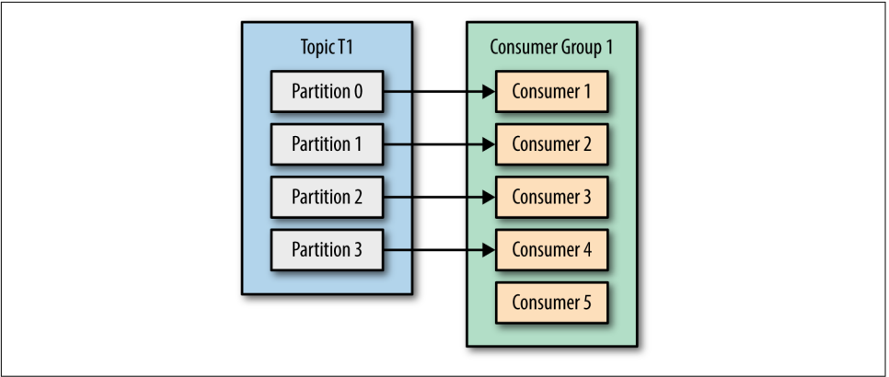
more consumers to a single group with a single topic than we have parti‐ tions,
=> some of the consumers will be idle and get no messages at all

Slide 94
The main way we scale data consumption from a Kafka topic is by adding more consumers to a consumer group.
It is common for Kafka consumers to do high-latency operations such as write to a database or a time-consuming computation on the data.
In these cases, a single consumer can’t possibly keep up with the rate data flows into a topic, and adding more consumers that share the load by having each consumer own just a subset of the partitions and messages is our main method of scaling.
This is a good reason to create topics with a large number of partitions—it allows adding more consumers when the load increases

Slide 95
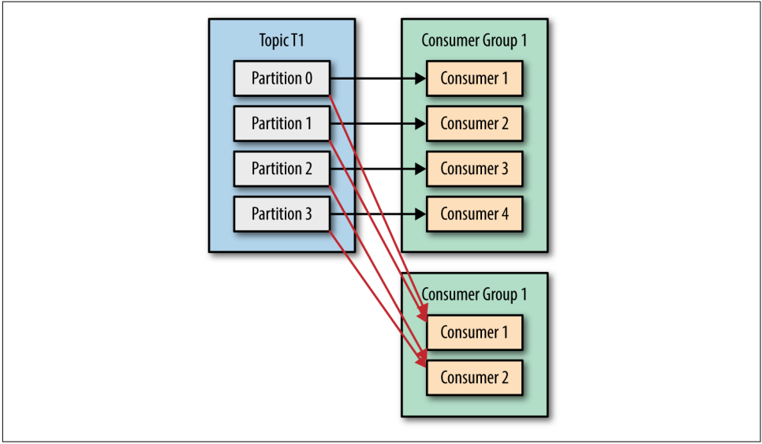
Unlike many traditional messaging systems, Kafka scales to a large number of consumers and consumer groups without reducing performance.

Slide 96
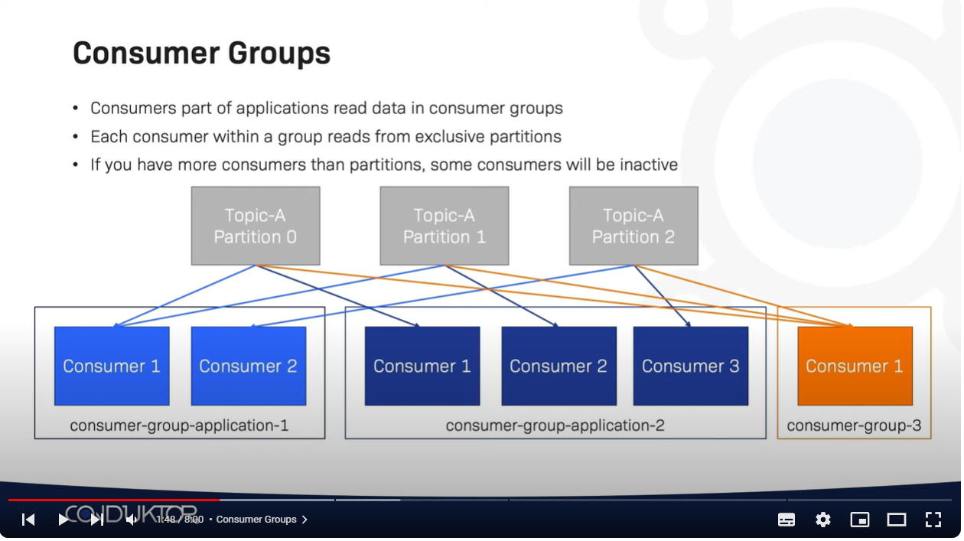

Slide 97
Consumer Groups and Partition Rebalance
When we add a new consumer to the group, it starts consuming messages from partitions previously consumed by another consumer
When a consumer shuts down or crashes; it leaves the group, and the partitions it used to consume will be consumed by one of the remaining consumers
Reassignment of partitions to consumers also happen when the topics the consumer group is consuming are modified (e.g., if an administrator adds new partitions)

Slide 98
Rebalances are important because they provide the consumer group with high availa‐ bility and scalability (allowing us to easily and safely add and remove consumers)
The way consumers maintain membership in a consumer group and ownership of the partitions assigned to them is by sending heartbeats to a Kafka broker designated as the group coordinator (this broker can be different for different consumer groups)
As long as the consumer is sending heartbeats at regular intervals, it is assumed to be alive, well, and processing messages from its partitions. Heartbeats are sent when the consumer polls (i.e., retrieves records) and when it commits records it has consumed

Slide 99
If the consumer stops sending heartbeats frequency for long enough, its session will time out and the group coordinator will consider it dead and trigger a rebalance
If a consumer crashed and stopped processing messages, it will take the group coordinator a few seconds without heartbeats to decide it is dead and trigger the rebalance
When closing a consumer cleanly, the consumer will notify the group coordinator that it is leaving, and the group coordinator will trigger a rebalance immediately, reducing the gap in processing

Slide 100
Configuration a Kafka Consumer
A Kafka consumer : Has three mandatory properties
bootstrap.servers: List of host:port pairs of brokers that the producer will use to establish initial connection to the Kafka cluster
key. deserializer: Name of a class that will be used to deserialize the keys of the records we will pro‐ duce to Kafka : implement “org.apache.kafka.common.serialization.Serializer”
value. deserializer: Name of a class that will be used to deserialize the values of the records we will pro‐ duce to Kafka : implement “org.apache.kafka.common.serialization.Serializer

Slide 101
Creating a Kafka Consumer
Properties props = new Properties();
props.put("bootstrap.servers", "broker1:9092,broker2:9092"); // Required
props.put("group.id", "CountryCounter"); // Optional
props.put("key.deserializer", "org.apache.kafka.common.serialization.StringDeserializer"); // Required props.put("value.deserializer", "org.apache.kafka.common.serialization.StringDeserializer"); // Required
KafkaConsumer consumer = new KafkaConsumer(props);

Slide 102
Subscribing to Topics
Once we create a consumer, the next step is to subscribe to one or more topics. The subcribe() method takes a list of topics as a parameter, so it’s pretty simple to use:
consumer.subscribe(Collections.singletonList("customerCountries"));
It is also possible to call subscribe with a regular expression
consumer.subscribe("test.*");

Slide 103
The Poll Loop
Once the consumer subscribes to topics, the poll loop handles all details of
Coordination,
Partition
Rebalances,
Heartbeats and data fetching
leaving the developer with a clean API that simply returns available data from the assigned partitions
poll() returns a list of records written to Kafka Broker that consumers in our group have not read yet

Slide 104
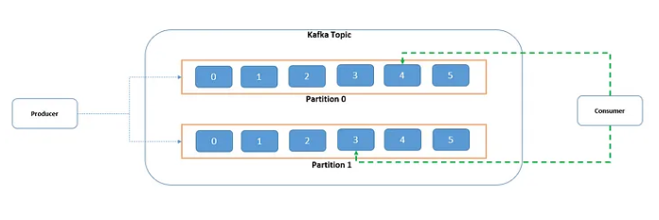
Commits and Offsets
A kafka offset is a unique identifier for each message within a kafka partition.
It helps consumers keep track of their progress like how many messages each consumer has already consumed from a partition so far and where to start next from.
=> Please note, offset is unique only within a partition, not across partitions.
This way if the consumer crashes or gets replaced by a new one, the latest committed message offset will help it resume from the exact point where it was left.

Slide 105
Commit: action of updating the current position in the partition
Last committed message offset for the consumer for partition 0 is 4
Automatic Commit:
The easiest way to commit offsets is to allow the consumer to do it for you. If you configure enable.auto.commit=true, then every five seconds the consumer will commit the largest offset your client received from poll()
We can set auto.commit.interval.ms property to change this default 5 seconds interval. Sample code snippet below with auto commit enabled with 1 second interval

Slide 106
Properties props = new Properties(); props.setProperty("bootstrap.servers", "localhost:9092"); props.setProperty("group.id", "test"); props.setProperty("enable.auto.commit", "true"); props.setProperty("auto.commit.interval.ms", "1000");

Slide 107
Commit Current Offset
Asynchronous Commit
Commit Specifed Offset

Slide 108
How Do We Exit the poll loop
When you decide to exit the poll loop cleanly
you must call consumer.close(). Closing the consumer will commit offsets if needed and will send the group coordinator a message that the consumer is leaving the group
will need another thread to call consumer.wakeup()

Slide 109
Zookeper

Slide 110
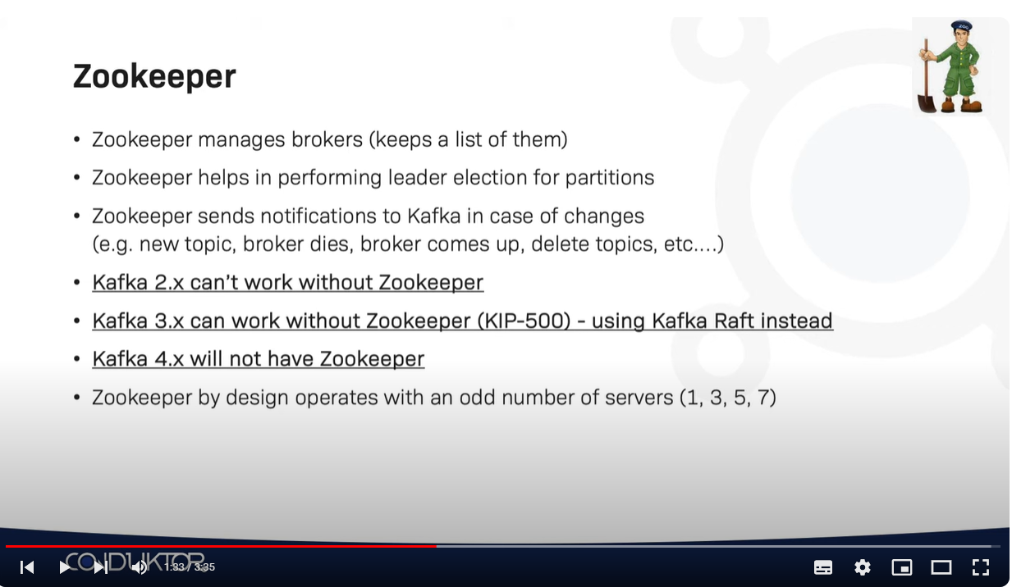

Slide 111


Slide 112
Security
in Apache Kafka

Slide 113


Slide 114


Slide 115


Slide 116


Slide 117


Slide 118
Demo (Examples)

Slide 119


Slide 120


Slide 121
Code source

Slide 122


Slide 123

Random Partitions !

Slide 124


Slide 125
Demo with Code source

Slide 126


Slide 127


Slide 128


Slide 129


Slide 130


Slide 131


Slide 132


Slide 133


Slide 134


